Slide 1










Terror attacks 1970-2016
Vladimir JN Bykov

Slide 2
Questions explored
1. We are very frequently hear about suicide style of terror attacks. Was it always like that?
2. The aim of attacks: demands to be satisfied or attacks in the true meaning of terror- kill people?
3. How a number of terror attacks distributed in 1970-2016?
4. Which type of weapond are most frequently deployed?
5. Which types of targets are usually selected?
6. Are there any relationship between arms export and a number of terror attacks?
7. Are there any particularly dangerous days/ months in a pattern of terror activities? When it is safe to go out?

Slide 3
Dataset parameters
How the extracted parameters from data set are related to each other:
- country
- year
- success of operation
- suicide style of attack
- terror groups
- weapons deployed
- number of persons killed
- number of wounded,
- whether hostages been taken

Slide 4
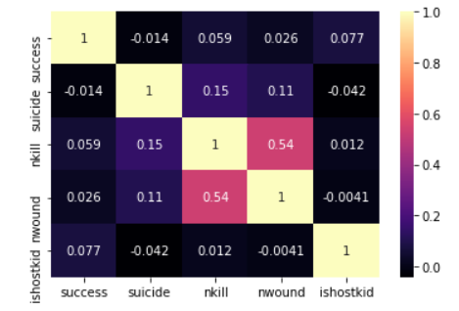
Overview: correlation
Moderate correlation between number of killed and wounded
Most of variables are categorical thus they are excluded from correlation matrix

Slide 5
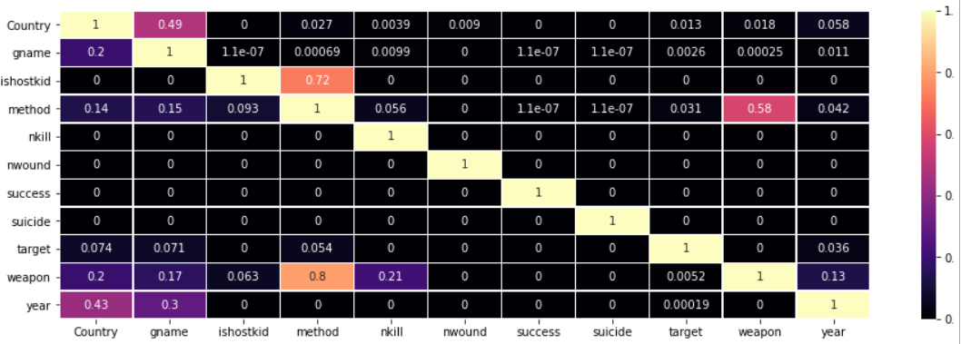
Overview: Alternative method: Predictive power score (0-1)
- A chosen weapon predicts the method of attack and a method even stronger predicts the used weapon
- A choice of method predicts whether hostages are taken, but not other way around
- A number of killed predicts a chosen weapon but not other way around
- A chosen target is poor predictor of the used method
- A choice of the terror group predicts a country they operate, weapon and method they will use. A group has association with the year, groups are emerging and disappearing.
- An attacked country was a predictor for attack year, weapon of choice, method of attack and terror group.

Slide 6
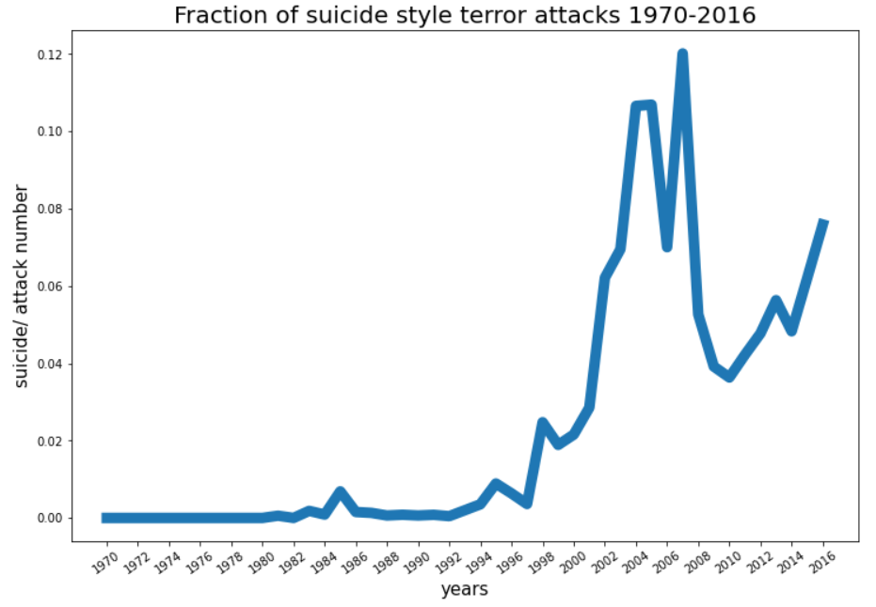
How attack style changes over years
Before 1996-98 suicide style of attacks were unkommon

Slide 7
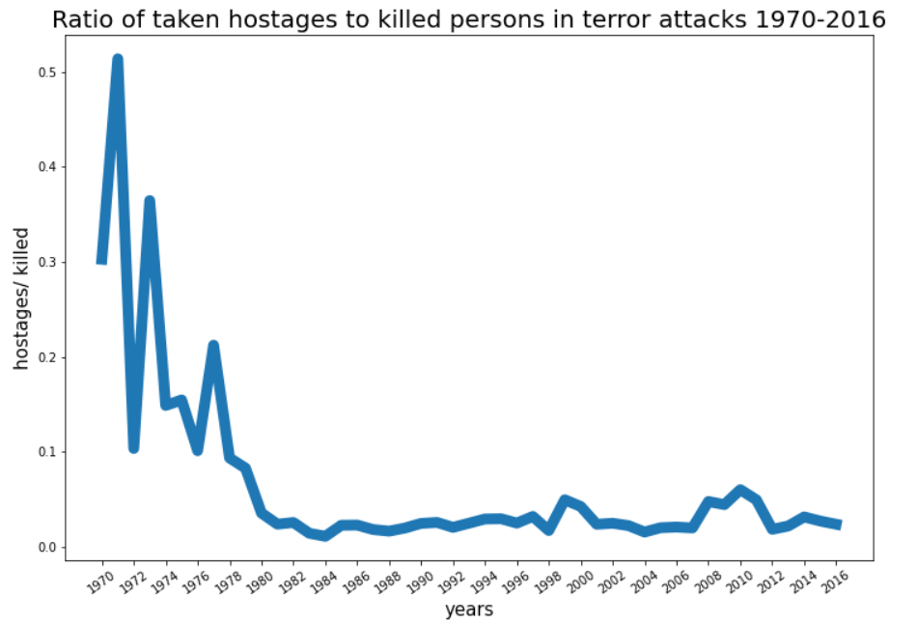
Purpose of terror attacks was changing over years
In 1970-80 a large fraction of attacks was a hostage taken operations where hostages were intend to be exchange on different demands. Nowadays usually no demands, no negotiations, the only purpose of attacks is a pure terror

Slide 8
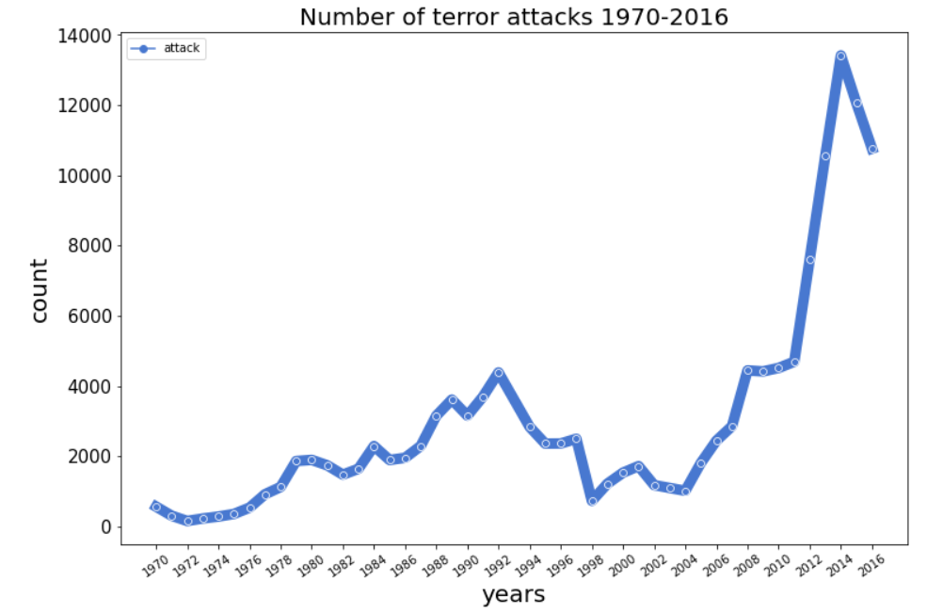
Two waves of terror attacks
1979-1987 USSR intervention in Afganistan, 1980s-2008 FARC Colombia, Intifada 1987 to 1993 Arab-Israeli conflict
2003 US invasion of Iraq/ Afghanistan, new wave began, bombing of Libya, civil war 2011-, civil war in Syria 2011, Yemen 2014-

Slide 9
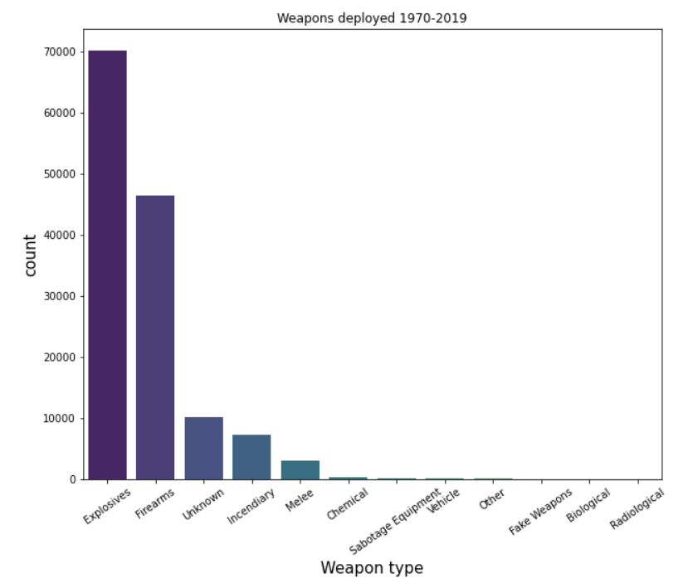
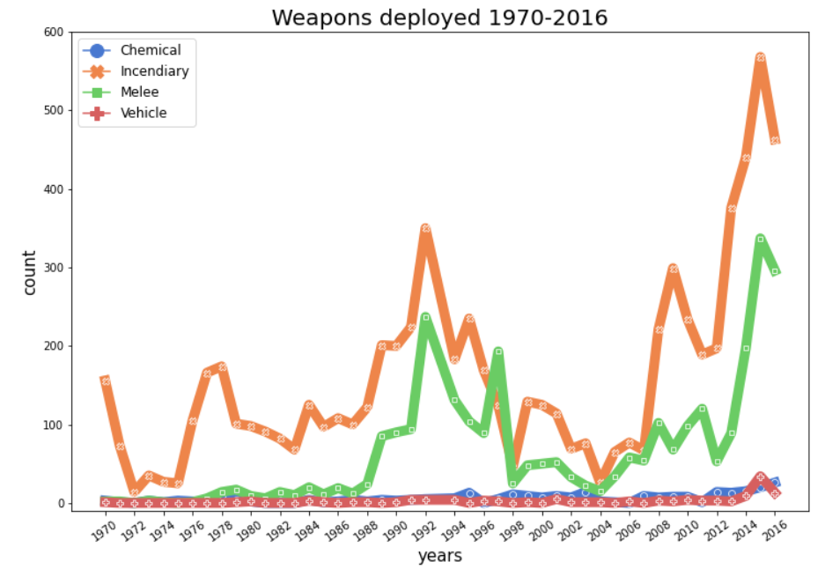
Weapons deployed in attacks

Slide 10
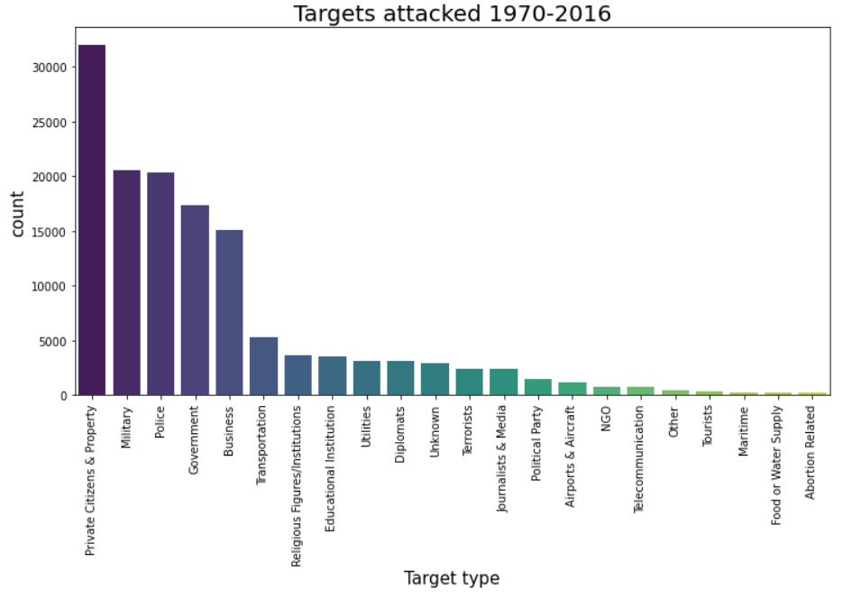
Targets for the terror attacks 1970-2016

Slide 11
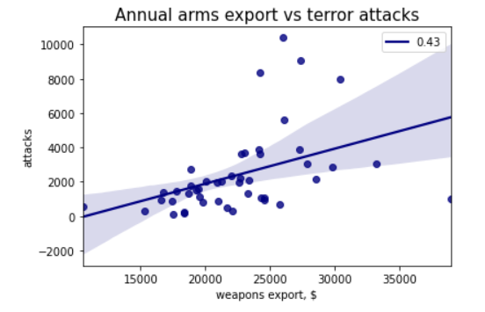
Arms export correlates with frequency of terror attacks

Slide 12
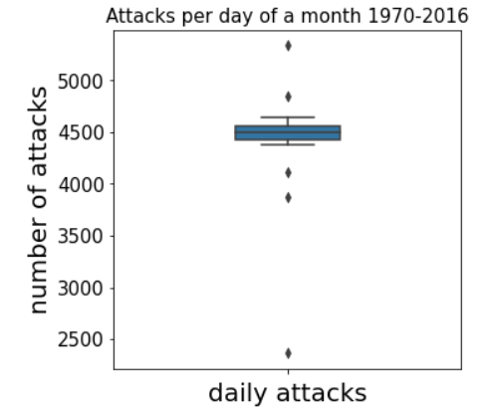
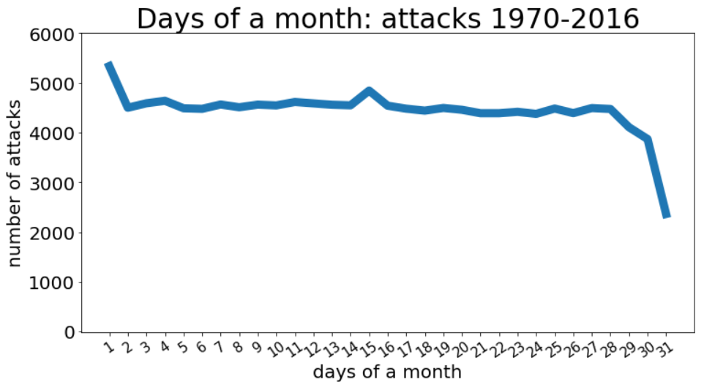
The most dangerous day of the month

Slide 13
Main conclusions from the analysis
- On average, a suicide style of attacks is a relatively new phenomena
- The terror attacks are no longer driven by political demands and forced negotiations. Taken hostages is now uncommon, and rather killing people is the new norm.
- A dominant weapon deployed are explosives
- A dominant target are private citizens
- Weapon export correlates with terror activity
- A terror attack is likely to occur on the first day of a month and least likely on the last day of the month. Psycology is likely to play an effect. Even terrorists prefer a fresh start and it usually co-insides with a new day of a new month.

Slide 14
Challenges
Merging two different data sets
Working with categorical variables: using predictive power data
score as a complement for correlation analysis
Learnings / highlights

Slide 15
Potential improvements
Going more into the details of the dataset, likewise regions of the world and individual countries
Finding better and/or more interesting datasets as a complement to the main one

Slide 16
Thank you

